Slide 1
Life Insurance Benefits
ACTU 301 Life Contingencies 1
Lecture 4

Slide 2





Introduction to life insurance functions
Financial mathematics review
A life assurance (or life insurance) policy is a contract which promises to pay a specified sum, b say, on the death of a given life (the life assured) at any future time, or between certain specified dates.
The death benefit b is called the sum assured/insured; it may be level (constant) or it may increase or decrease in a manner specified in the contract.
Policies under which payments depend on the death or survival of more than one life may also be issued.
The valuation of benefits involve some interest theory functions.
Given an annual effective interest rate i, the annual interest rate convertible mthly satisfies:
and if the interest is compounded continuously we use the force of interest which is given by
We shall for now consider contracts issued on the life of one person.
We shall further focus on level benefit policies which pay the same amount of benefit regardless of the time at which the benefit is paid.
Benefit payments can be either made at the time the contingent event occurs or at some set time like the end of the year in which the contingent event occurs.
The annual effective discount rate can be defined in terms of the discount factor v as
We shall value benefits payments contingent on death or survival of a policyholder by combining time value of money and survival models.
where
In particular, we shall use the future lifetime random variable T_{x} to determine the value of a benefit payable immediately on the contingent event of an individual, and the curtate future lifetime random variable K_{x} for when a payment is made at the end of the year in which the contingent event occurs.
Finally, given d, the annual discount rate convertible mthly satisfies
We shall develop formulas for the expected present value of the benefits paid by an insurance company for a number of different contract types.

Slide 3

I. Whole Life Insurance
Whole Life Insurance payable at the moment of death
Whole Life Insurance payable at the moment of death
By a whole life insurance we mean an insurance that makes a benefit payment at the time of death of the insured person, no matter when that time might be.
The diagram below illustrates the mechanism of a unit-benefit continuous whole life insurance:
The models will be developed with a benefit function b and a discount function v;
Present value GH₵1 × V^{T}
Death occurs
A benefit of GH₵1 is paid here
To simplify calculations, we assume for now that the benefit amount is equal to GH₵1 (called unit insurance).
So that the benefit function is
Time from now
b_{Tx} = 1, for all T_{x} ≥ 0.
0
T_{x}
(Age x)
Multiplying the benefit function with the discount factor for a period of T_{x} years, we obtain the present value random variable
$$Z=v^{T_{x}}$$
for all T_{x} ≥ 0.
Z denotes the present value random variable for a unit-benefit insurance policy.

Slide 4
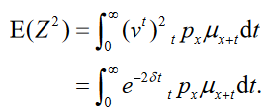
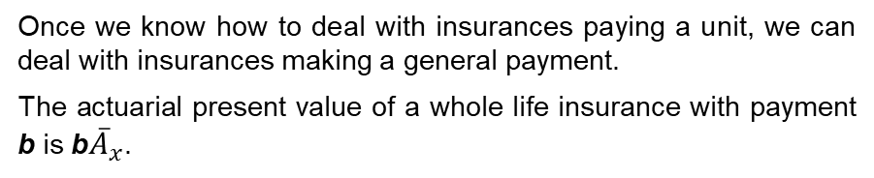
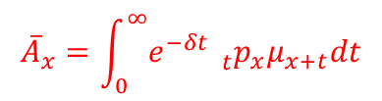

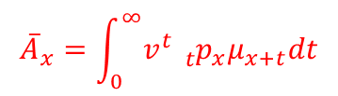
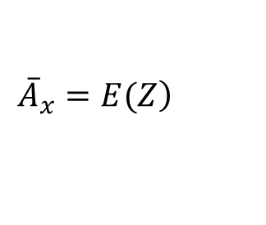

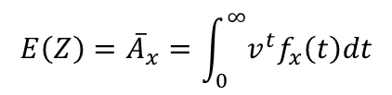
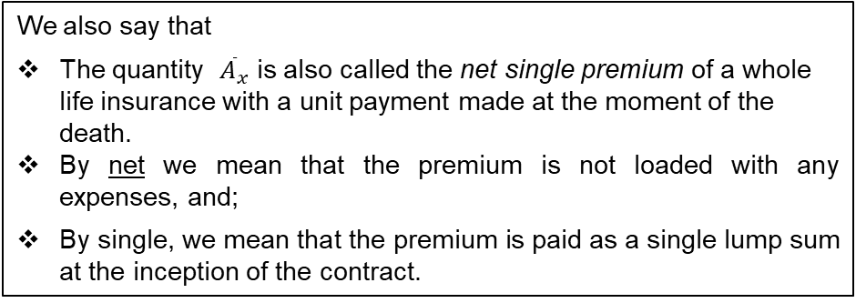
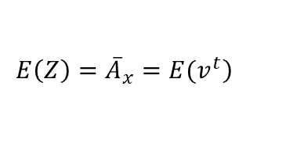
Whole Life Insurance payable at the moment of death
Whole Life Insurance payable at the moment of death
The average cost of a whole life insurance is referred to as the actuarial present value (APV) of the random variable Z.
Once we know how to deal with insurances paying a unit, we can deal with insurances making a general payment.
The actuarial present value of a whole life insurance with payment b is b${\overline{A}}_{x}$.
The average cost of a whole life insurance policy is represented as the expected value of Z (i.e. expected present value)
To calculate the expected value, we simply integrate out the product of Z and the density function of the underlying random variable T_{x}, that is,
Thus
The average cost =
APV
$$=E(Z)$$
$${\overline{A}}_{x}$$
For a life aged x, this average cost E(Z) would be denoted by
$$\left.E\left(Z\right)={\overline{A}}_{x}=E(v^{t}\right)$$
$$\left.{\overline{A}}_{x}=E(Z\right)$$
$$E\left(Z\right)={\overline{A}}_{x}=\int_{0}^{∞}{v^{t}f_{x}\left(t\right)dt}$$
In the symbol,
The A stands for the APV of a life insurance,
The x indicates the age of the policyholder at the beginning of the contract.
The bar over the A indicates that this average cost is calculated on a continuous basis (i.e. at the time of death)
$${\overline{A}}_{x}=\int_{0}^{∞}{v^{t}{}_{t}^{}{p_{x}}μ_{x+t}dt}$$
$${\overline{A}}_{x}=\int_{0}^{∞}{e^{−δt}{}_{t}^{}{p_{x}}μ_{x+t}dt}$$
if there is a limiting age, we replace ∞ with ω – x
We also say that
The quantity ${\overline{A}}_{x}$ is also called the net single premium of a whole life insurance with a unit payment made at the moment of the death.
By net we mean that the premium is not loaded with any expenses, and;
By single, we mean that the premium is paid as a single lump sum at the inception of the contract.
To calculate the variance of Z, we can make use of the identity
Var(Z) = E(Z²) – [E(Z)]² .
where

Slide 5



Whole Life Insurance payable at the moment of death
We observe that the formula for E(Z²) is the same as that for E(Z), except that δ is replaced with 2δ.
To obtain E(Z²), we simply evaluate E(Z) at two times the original force of interest.
We denote E(Z²) for a continuous unit-benefit whole life insurance by ${{}_{}^{2}{\overline{A}}}_{x}$ .
E(Z²) =
${{}_{}^{2}{\overline{A}}}_{x}$
The superscript 2,indicates that the quantity is E(Z) calculated at 2δ.
$$Var\left(Z\right)={{}_{}^{2}{\overline{A}}}_{x}−{\left({\overline{A}}_{x}\right)}^{2}$$
The result that E(Z²) is E(Z) evaluated at 2δ is applicable to not only a unit-benefit whole life insurance, but also any insurance policy with b_{Tx} = 0 or 1 for all Tx.

Slide 6
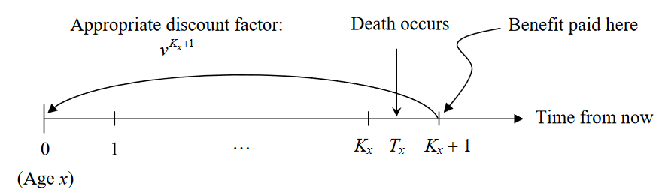

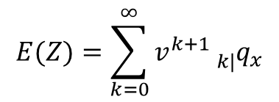
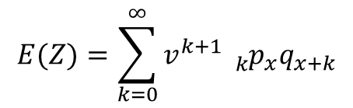
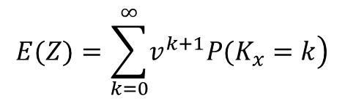
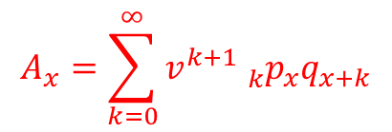
Whole Life Insurance payable at the end of the year of death
Whole Life Insurance payable at the end of the year of death
Suppose that the death benefit is payable at the end of the year of death (years being measured from the date of issue of the policy).
This means that E(Z) should be calculated as a summation instead of an integral, and it should based on the probability function of K_{x}
The present value random variable for this benefit is
The Actuarial Present Value of this policy for life (x) with one unit in benefits payable at the end of the year of death is given by the formula
$$Z=v^{K_{x}+1}$$
for K_{x} = 0, 1, 2, ... .
$$E(Z)=\sum_{k=0}^{∞}{\left.v^{k+1}P(K_{x}=k\right)}$$
Here, Z depends on a discrete random variable (K_{x}).
$$E(Z)=\sum_{k=0}^{∞}{v^{k+1}}{}_{k|}^{}{q_{x}}$$
The timing of the death benefit is illustrated by the following diagram.
$$E(Z)=\sum_{k=0}^{∞}{v^{k+1}}{}_{k}^{}{p_{x}}q_{x+k}$$
We denote E(Z) by A_{x}
$$A_{x}=\sum_{k=0}^{∞}{v^{k+1}{}_{k}^{}{p_{x}}q_{x+k}}$$

Slide 7

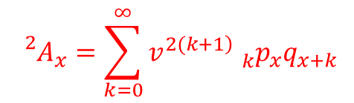
Whole Life Insurance payable at the end of the year of death
Whole Life Insurance payable at the end of the year of death
The second moment of Z is denoted by ²A_{x} and is given by
Example
Let the remaining lifetime at birth random variable X be uniform on [0,100].
Let Z₃₀ be the contingent payment random variable for a life aged x = 30.
Find A₃₀, ²A₃₀, and Var(Z₃₀) if δ = 0.05.
$${{}_{}^{2}A}_{x}=\sum_{k=0}^{∞}{v^{\left.2(k+1\right)}{}_{k}^{}{p_{x}}q_{x+k}}$$
The variance of Z is then
$$Var\left(Z\right)={{}_{}^{2}A}_{x}−{\left(A_{x}\right)}^{2}$$

Slide 8


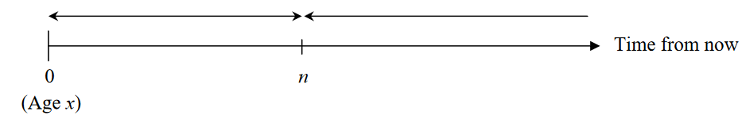


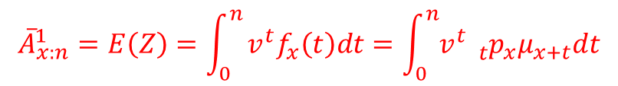
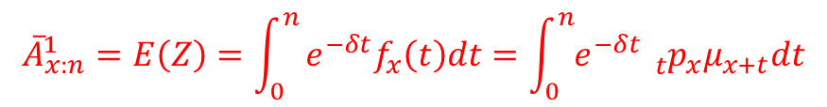
II. Term (or temporary) assurance/Term life insurance
n-year term insurance payable immediately on the death
An n-year term life insurance is a policy where the payment is made only when the insured person dies within n years of the policy's issue. That is, if the insured survives n years, no benefit is paid.
If the benefit is payable immediately on death, the present value (as a random variable) is
That is, a term (or temporary) assurance contract pays a sum assured on the death of (x) within the term of the policy, which we usually write as n years.
Consider an n-year term insurance with unit benefit payable immediately on the death of an individual. If the individual is currently aged x, the benefit will be paid in T_{x} years given T_{x} ≤ n, therefore, to get the present value of a unit benefit the payment must be discounted by T_{x} years.
The expected value of Z, sometimes referred to as the actuarial present value (APV) and denoted by is
$${\overline{A}}_{x:n}^{1}$$
$${\overline{A}}_{x:n}^{1}=E\left(Z\right)=\int_{0}^{n}{e^{−δt}f_{x}\left(t\right)dt=\int_{0}^{n}{e^{−δt}{{}_{t}^{}p}_{x}μ_{x+t}dt}}$$
The benefit function is given by
$${\overline{A}}_{x:n}^{1}=E\left(Z\right)=\int_{0}^{n}{v^{t}f_{x}\left(t\right)dt=\int_{0}^{n}{v^{t}{{}_{t}^{}p}_{x}μ_{x+t}dt}}$$
The payout from a unit-benefit n-year term life insurance is illustrated in the following diagram.
In actuarial notation,
The bar above the A denotes that the benefit is payable immediately on death,
The ‘1’ above the x indicates that for the benefit to be paid the life must die before the end of the n-year term.
The subscript indicates that coverage is provided for at most n years.
Death occurs here: Pay GH₵1 at the moment of death
Death occurs here: Pay nothing

Slide 9






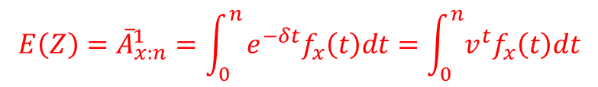
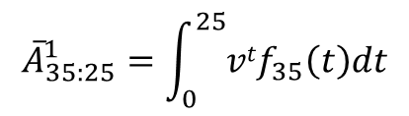
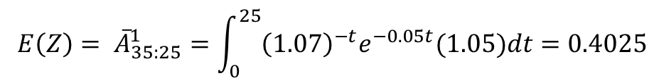
n-year term insurance payable immediately on the death
Example
The age-at-death random variable is exponential with parameter 0.05. A life
aged 35 buys a 25-year life insurance policy that pays 1 upon death. Assume an annual effective interest rate of 7%, find the actuarial present value of this policy.
This policy satisfies the criterion that
b_{Tx} = 0 or 1 for all T_{x}
Solution
The actuarial present value of this policy is
E(Z²) is E(Z) evaluated at 2δ is applicable
$${E\left(Z\right)=\overline{A}}_{x:n}^{1}=\int_{0}^{n}{e^{−δt}f_{x}\left(t\right)dt=\int_{0}^{n}{v^{t}f_{x}\left(t\right)dt}}$$
Hence, we have
Given x= 35, n= 25 i =0.07
$${\overline{A}}_{35:25}^{1}=\int_{0}^{25}{vtf_{35}\left(t\right)dt}$$
That is evaluated at 2δ
Pdf of exponential distribution
$${f_{35}\left(t\right)=f}_{35}\left(t\right)={λe}^{−λt}=0.05e^{−0.05t}$$
On substitution we obtain
$$E\left(Z\right)= {\overline{A}}_{35:25}^{1}=\int_{0}^{25}{{\left(1.07\right)}^{−t}e^{−0.05t}(1.05)dt}=0.4025$$

Slide 10

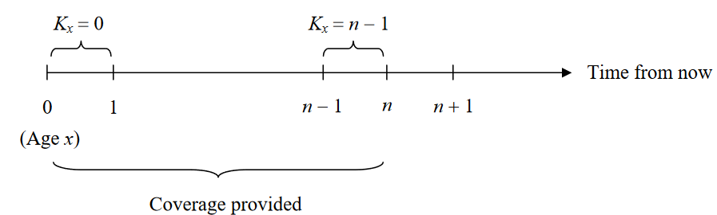


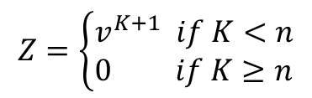
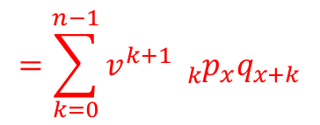
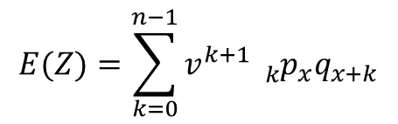
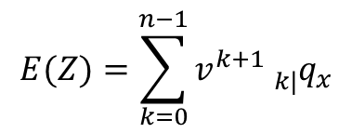
Term Life Insurance payable at the end of the year of death
Term Life Insurance payable at the end of the year of death
$$E(Z)=\sum_{k=0}^{n−1}{v^{k+1}}{}_{k}^{}{p_{x}}q_{x+k}$$
If the sum assured is payable at the end of year of death (if this occurs within the n year term), we have the present value
$$Z=\left\{\begin{aligned}&v^{K+1} if K<n \\ &0 if K≥n\end{aligned}\right.$$
We denote E(Z) by
$$=\sum_{k=0}^{n−1}{v^{k+1}}{}_{k}^{}{p_{x}}q_{x+k}$$
We should expect E(Z) for a term life insurance to be the same as that for a whole life insurance, except that the upper limit of the summation is no longer ∞.
As before, indicates that this policy will last for at most n years,
The 1 above x indicates that the policy is a term life insurance.
There is no bar above A, because the policy is discrete rather than continuous.
From the diagram above, you can see that the summation should run from k = 0 to k = n – 1
Hence, E(Z) for a unit-benefit term life insurance is given by
E(Z²) is the same as E(Z) evaluated at 2δ
$$E(Z)=\sum_{k=0}^{n−1}{v^{k+1}}{}_{k|}^{}{q_{x}}$$
Hence, we have
E(Z²) =

Slide 11
Term Life Insurance payable at the end of the year of death
Example 1
For this problem, recall
We have

Slide 12




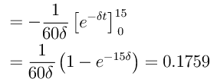

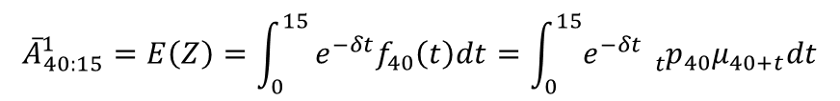
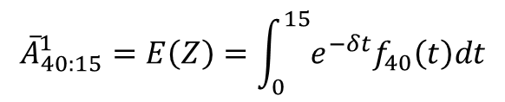

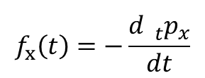
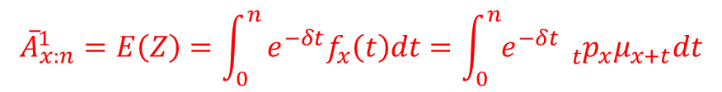
Example
An individual currently aged 40 purchases a 15-year term insurance that pays a benefit of GH₵50,000 immediately on death. If the force of interest is δ= 0.05 and
Since we have not been given the force of mortality, it is much easier to compute the APV of the benefit using the formula involving the density, where
(i) Find the APV of the death benefit.
(ii) Find the standard deviation of the present value random variable.
Recall
$$f_{x}\left(t\right)=−\frac{d{{}_{t}^{}p}_{x}}{dt}$$
Solution
(i) The APV to be calculated is
$${\overline{A}}_{40:15}^{1}=E\left(Z\right)=\int_{0}^{15}{e^{−δt}f_{40}\left(t\right)dt=\int_{0}^{15}{e^{−δt}{{}_{t}^{}p}_{40}μ_{40+t}dt}}$$
The APV of a unit benefit is therefore
By applying
$${\overline{A}}_{40:15}^{1}=E\left(Z\right)=\int_{0}^{15}{e^{−δt}f_{40}\left(t\right)dt}$$
$${\overline{A}}_{x:n}^{1}=E\left(Z\right)=\int_{0}^{n}{e^{−δt}f_{x}\left(t\right)dt=\int_{0}^{n}{e^{−δt}{{}_{t}^{}p}_{x}μ_{x+t}dt}}$$
$${\overline{A}}_{40:15}^{1}$$
Hence for a life aged 40,

Slide 13

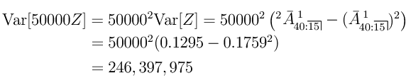

However, since the policy pays GH₵50,000 on death, the APV of the benefit is
$${\overline{A}}_{40:15}^{1}$$
GH₵ 50,000 = GH₵50,000 × 0.1759 = GH₵8,793.89
Using the rule of moments, the second moment of the present value random variable is
When finding the variance we need to make sure we find it for the total benefit and not just a unit benefit

Slide 14


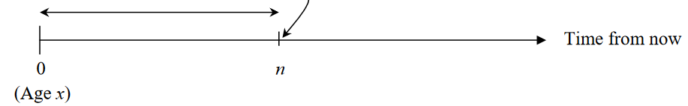
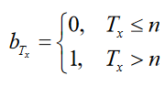


III. Pure Endowment
Z is a discrete random variable that takes only two values, 0 with probability _{n}q_{x}, and v^{n} with probability _{n} p_{x}, therefore, the expected value of Z is given by
An n-year pure endowment provides a payment at the end of n years if the policyholder survives, but makes no payment if the policyholder dies within n years.
E(Z)
If we assume the benefit amount is GH₵1. The payout from a unit benefit n-year pure endowment is illustrated in the diagram below
We denote E(Z) for a unit-benefit pure endowment by
Death occurs here: Pay nothing
Pay GH₵1 at time n if the policyholder is alive at time n
=
The 1 above indicates that the policy is a pure endowment.(i.e. for the benefit to be paid the term must expire before the life).
We do not write a bar above A, because the payment is made at time n instead of time T_{x} (as there only exists a discrete time version)
The benefit function is given by
For an n-year pure endowment insurance a benefit is paid if the individual dies after n years, that is T_{x} ≥ n. Since the benefit is only ever paid after n years, the present value random variable is
There are two actuarial notations for the actuarial present value:
It may be denoted by
This notation leads to a possibility of confusion between the term and pure endowment insurance policies. For this reason, the APV of the pure endowment insurance is often denoted by _{n}E_{x}.
$$A_{x:n}^{ 1}={{}_{n}^{}E}_{x}=v^{n}{}_{n}^{}{p_{x}}$$

Slide 15




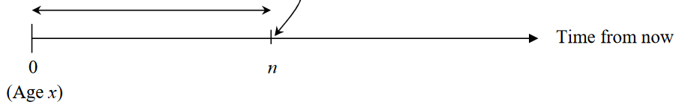


IV. Endowment Insurance
The second moment of Z can be calculated in the same way as for any discrete random variable
An n-year endowment insurance provides an amount to be paid at the moment of death if death occurs in the next n years or at the end of year n if the policyholder survives to that time.
As before, we assume that the benefit amount is GH₵1.
The payout from a unit-benefit n-year endowment insurance is illustrated in the diagram below
Death occurs here:
Pay GH₵1 at the moment of death
Pay GH₵1 at time n if the policyholder is alive at time n
The benefit function is b_{Tx} = 1 for all Tx.
Multiplying it with appropriate discount factors, we obtain the present value random variable

Slide 16








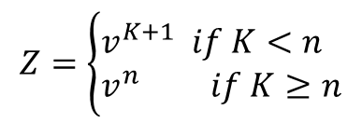
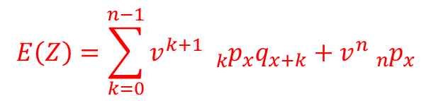
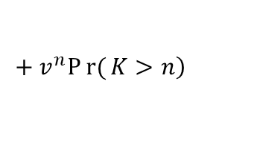

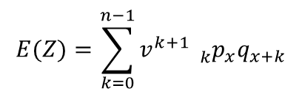

Endowment payable at the moment of death
Endowment payable at the end of the year of death
It can be observed that an n-year endowment insurance is simply a combination of an n-year term insurance and an n-year pure endowment.
Similarly, if the death benefit is payable at the end of the year of death, the present value is
$$Z=\left\{\begin{aligned}&v^{K+1} if K<n \\ &v^{n} if K≥n\end{aligned}\right.$$
It follows that E(Z) for an n-year endowment insurance can be expressed as
$$E(Z)=\sum_{k=0}^{n−1}{v^{k+1}}{}_{k}^{}{p_{x}}q_{x+k}$$
$$\left.{+ v}^{n}Pr{(}K>n\right)$$
We denote E(Z) by
$$E\left(Z\right)=\sum_{k=0}^{n−1}{v^{k+1}}{}_{k}^{}{p_{x}}q_{x+k}+v^{n}{}_{n}^{}{p_{x}}$$
$${\overline{A}}_{x:n}^{ }={{\overline{A}}_{x:n}^{ 1}+A}_{x:n}^{ 1}$$
Note that there is no 1 above either x or .
Recall that an n-year endowment insurance is just a combination of an n-year term life insurance and an n-year pure endowment. Hence, we have
This policy satisfies the criterion that
b_{Tx} = 0 or 1 for all T_{x}
E(Z²) is E(Z) evaluated at 2δ is applicable
We denote E(Z) by
Hence we have
Hence, we have
That is evaluated at 2δ
$$A_{x:n}^{ }={A_{x:n}^{ 1}+A}_{x:n}^{ 1}$$
E(Z²) is E(Z) evaluated at 2δ is applicable

Slide 17





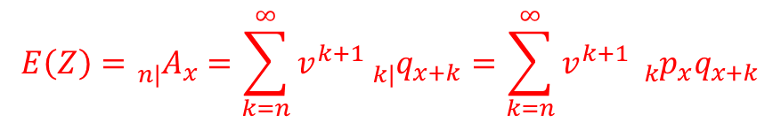
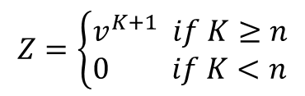
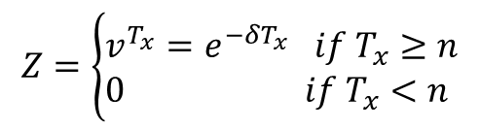
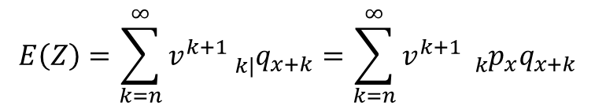
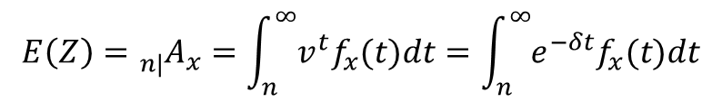
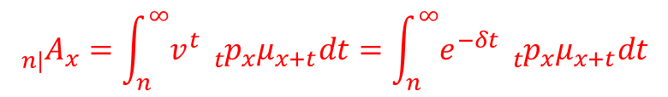

V. Deferred Life Insurance
A deferred assurance provides a benefit on the death of (x) if this occurs after a certain period, called the deferred period (or, more correctly, the period of deferment), which we usually write as n years.
if the sum assured is payable at the end of year of death
$$Z=\left\{\begin{aligned}&v^{K+1} if K≥n \\ &0 if K<n\end{aligned}\right.$$
If the benefit is payable immediately on death of (x) after the deferred period has elapsed, the present value is
The corresponding A.P.V.’s are written as
$$E\left(Z\right)=\sum_{k=n}^{∞}{v^{k+1}}{{}_{k|}^{}q}_{x+k}=\sum_{k=n}^{∞}{v^{k+1}}{}_{k}^{}{p_{x}}q_{x+k}$$
$$Z=\left\{\begin{aligned}&v^{T_{x}}=e^{−δT_{x}} if T_{x}≥n \\ &0 if T_{x}<n\end{aligned}\right.$$
The APV of a deferred insurance benefit is given as:
We denote E(Z) by _{n|}A_{x}.
$$E\left(Z\right)={}_{n|}^{}{A_{x}}=\int_{n}^{∞}{v^{t}f_{x}(t)dt}=\int_{n}^{∞}{e^{−δt}f_{x}(t)dt}$$
$$E\left(Z\right)={}_{n|}^{}{A_{x}}=\sum_{k=n}^{∞}{v^{k+1}}{{}_{k|}^{}q}_{x+k}=\sum_{k=n}^{∞}{v^{k+1}}{}_{k}^{}{p_{x}}q_{x+k}$$
We denote E(Z) by
E(Z) =
$${}_{n|}^{}{A_{x}}=v^{n}{{}_{n}^{}p}_{x}A_{x+n}$$
$${}_{n|}^{}{A_{x}}=\int_{n}^{∞}{v^{t}{}_{t}^{}{p_{x}}μ_{x+t}dt}=\int_{n}^{∞}{e^{−δt}{}_{t}^{}{p_{x}}μ_{x+t}dt}$$
The two relationships that we previously derived for continuous insurance functions also apply in the discrete case, that is
The variance of Z is

Slide 18


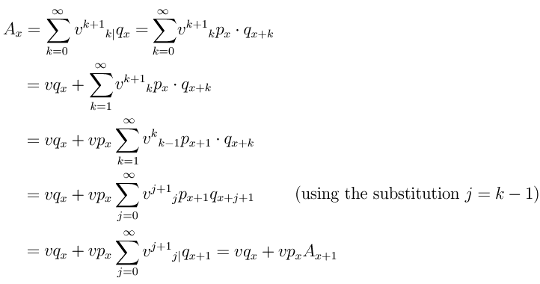
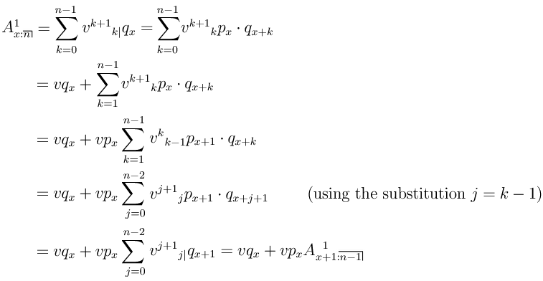
Recursive Relationships
Recursive Relationships
We now state and prove the recursive formulae for the whole life, term, deferred, and endowment insurance functions.
Term
whole life
Proof:
Proof:

Slide 19


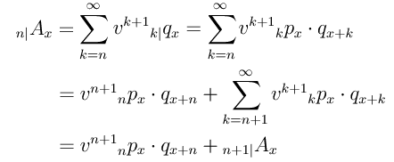
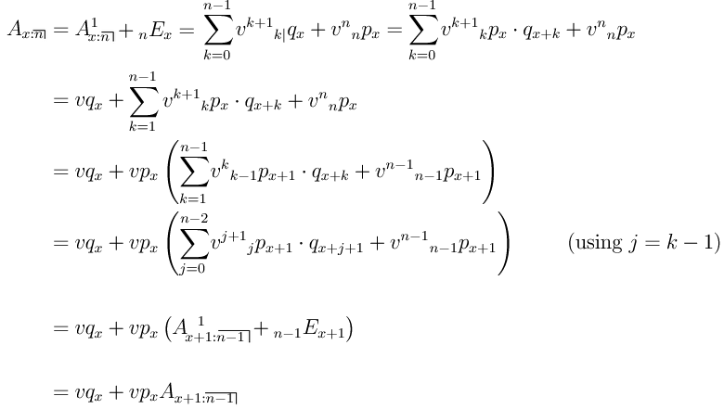
Recursive Relationships
Recursive Relationships
Deferred
Endowment
Proof:
Proof:

Slide 20


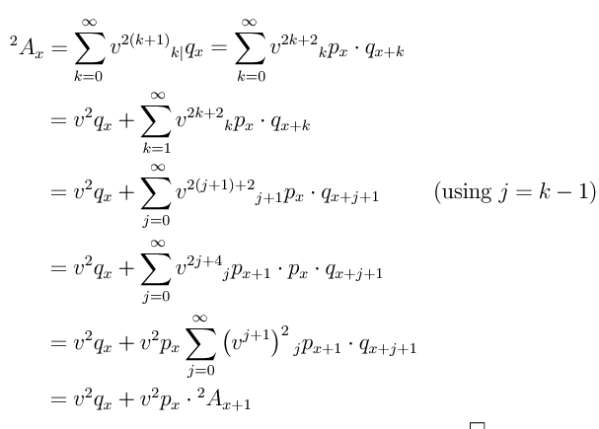


Recursive Relationships
Recursive Relationships
There also exist recursive formulae for the second moments of the present value random variable, however, since the proofs are similar to those for the first moment, we only prove the case for a whole life insurance.
For the other types of insurance the recursive formulae for the second moment are
Term
Whole life
Endowment
Deferred

Slide 21
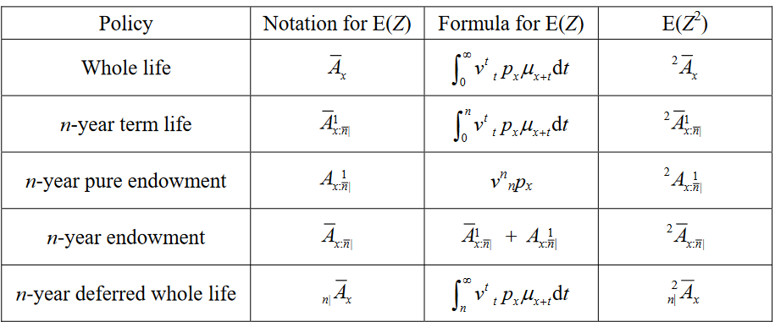

Continuous Insurances
Discrete Insurances

Slide 22
END

